Slide 1
THE REAL TIME PAD
Presented by,
Mohan Vamsi Kasukurthi
Tharani Konreddy

Slide 2

INTRODUCTION
Numbers produced from a process which results in unpredictable series of numbers and cannot be statistically reproduced.

Slide 3
PROPERTIES OF TRUE RANDOMNESS
Must be random..
Unpredictable
Uniformity.
Independent of previous or future values.
Infinite source.

Slide 4
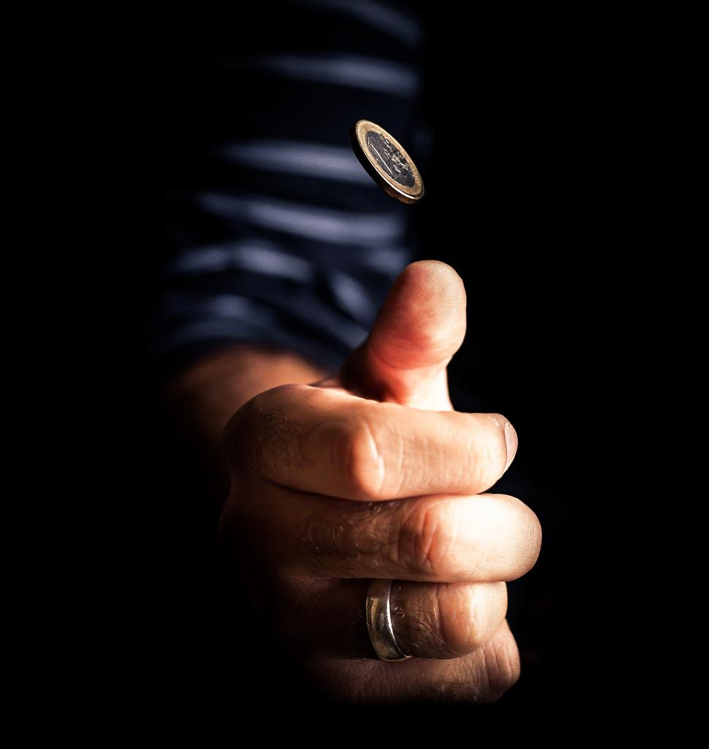
HISTORY
Dice.
Coin flips.
Lava lamps.
Radioactive decay???
Who have a pound of uranium
laying around???
But how many coins can you flip???

Slide 5
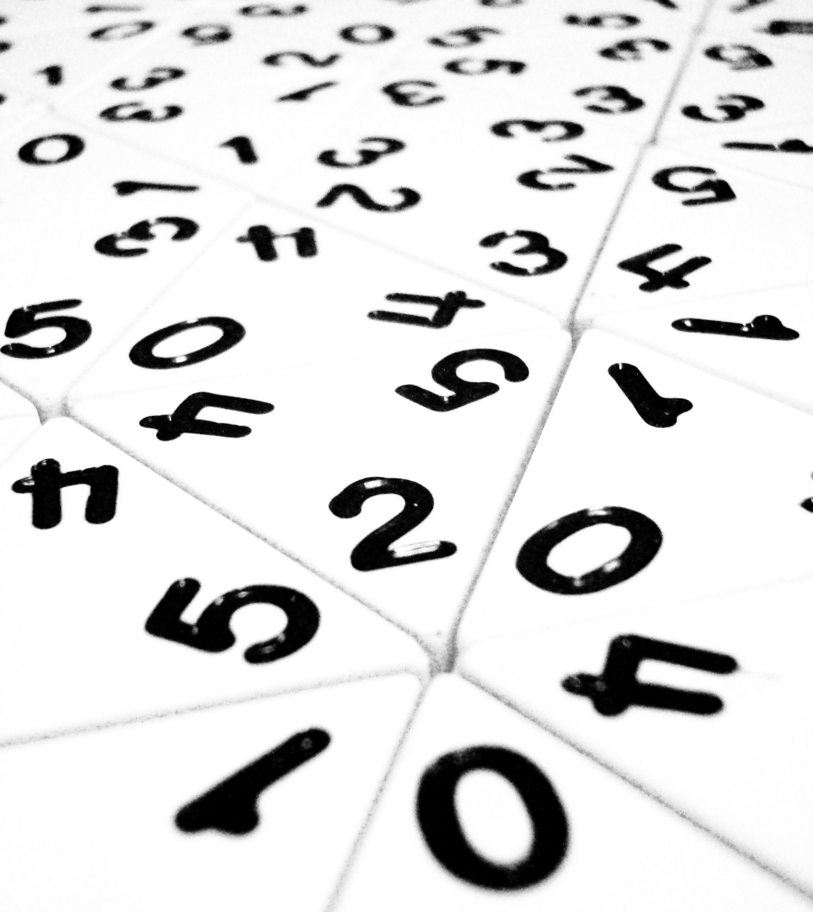
WHY IN THE WORLD DO WE NEED RANDOM NUMBERS
Cryptographic uses.
Casinos
Many other real time applications

Slide 6
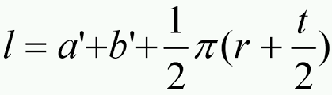
EXISTING AND POPULAR RANDOM NUMBER GENERATORS
Random.org→ Atmospheric noise.
Pseudo Random generators→ example:
How many people have twitter accounts?? And how many in future???

Slide 7
Problems with existing random generators
Hard to achieve infinite source of randomness.
Requires lot of computational power.
Most of the true random generators are expensive and labour intensive.
What if we can achieve true randomness using just a social media account???

Slide 8
Our Solution: The Real-Time Pad
Based on real-time data from the tweets by thousands of users.
Almost impossible to predict the free will of thousands of people at any time.
We process the streaming twitter data at a given time to produce the random characters/ bits.
Can be used as an excellent password generator.

Slide 9
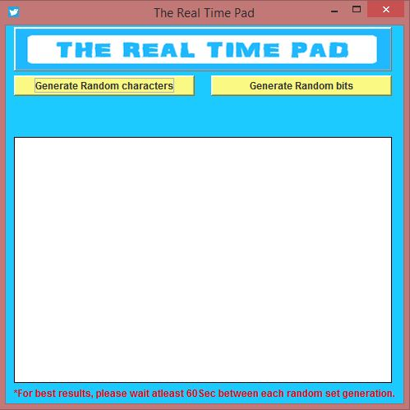

Slide 10

STANDARDS OF RTP
Username standards: How does the username must look like?
Password standards: How a password must be?
Account standards: Secured account settings.
Follower standards: Who and how many to follow?
Our standards provide different levels of security.

Slide 11
METHODOLOGY
All the users have same followers.
Users can generate at same time to obtain the same random series.
No problem of distribution.
Data from multiple twitter accounts to provide additional security.

Slide 12
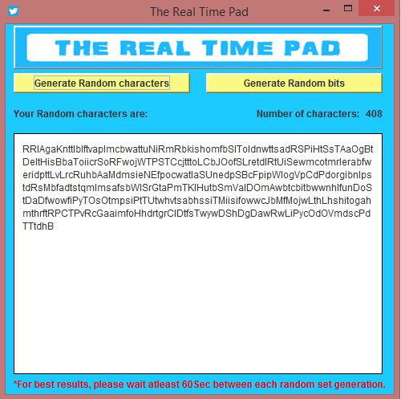

Slide 13
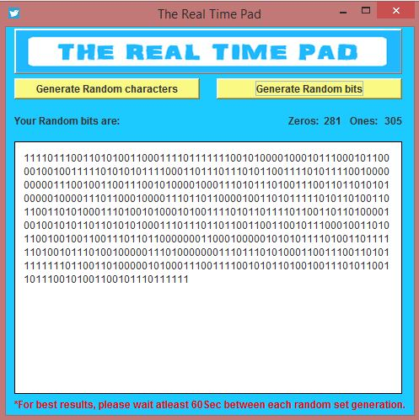

Slide 14
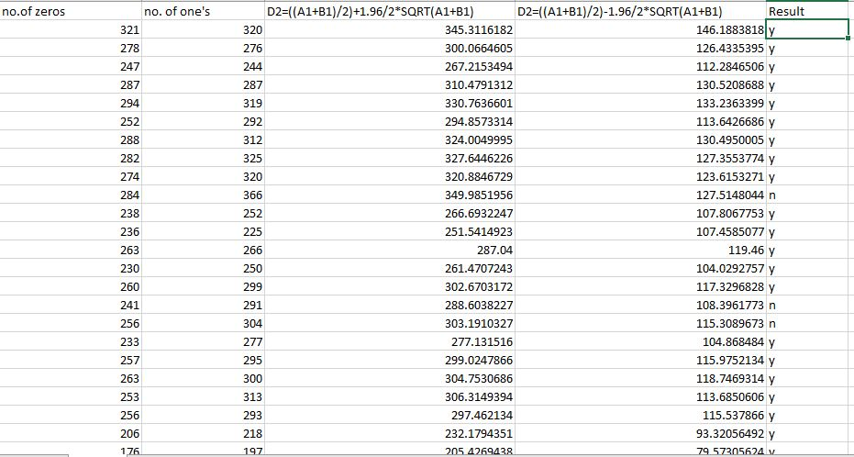
Testing results: Above 80% successful in the test.

Slide 15
REFERENCES
https://dev.twitter.com/docs.
https://www.statista.com/statistics/272014/global-social-networks-ranked-by-number-of-users/.
http://www.pewinternet.org/fact-sheet/social-media/.
https://en.wikipedia.org/wiki/Applications_of_randomness
http://arminstraub.com/teaching/cryptography-spring17
https://www.eg.bucknell.edu/~xmeng/Course/CS6337/Note/master/node37.html
http://anomaly.org/ThinAir/charactr.html

Slide 16
Thank You..

